Slide 1

IBM AICTE PROJECT
AI Agent for Digital Financial Literacy
Presented By: Shreya Saihgal
Student name : Shreya Saihgal
College Name & Department : Manipal University Jaipur, BTech in Information Technology

Slide 2
Outline
Problem Statement
Technology used
Wow factor
End users
Result
Conclusion
Git-hub Link
Future scope
IBM Certifications

Slide 3
Problem Statement
A large segment of the population lacks digital financial literacy, leading to:
Misuse of UPI, net banking and mobile wallets.
Exposure to online scams (phishing, OTP fraud)
Poor understanding of loans, interest rates, budgeting etc.
Language barriers due to limited regional content.
Proposed Solution:
Build an AI-powered agent using RAG on IBM Cloud Lite that:
Answers financial queries with verified data
Supports multiple regional languages
Promotes safe financial practices
Ensures accessibility, personalization and inclusivity

Slide 4
Technology used
IBM Cloud Lite (hosting and deployment)
IBM Granite Models (LLMs for natural language generation)
Watsonx.ai Studio (training and managing models)
Retrieval-Augmented Generation (RAG) (for combining LLMs with verified data)
Natural Language Processing (NLP)

Slide 5
IBM cloud services used
IBM Cloud Watsonx AI Studio
IBM Cloud Watsonx AI runtime
IBM Cloud Agent Lab
IBM Granite foundation model

Slide 6
Wow factors
Multilingual Support: Users can interact in Hindi, Bengali, Tamil and other regional languages for better accessibility.
RAG-enabled AI: Combines generative AI with real-time data from trusted sources like government and banking websites.
Scam Awareness Built-in: Educates users on common frauds like OTP scams and fake apps, ensuring safer digital transactions.
User-friendly Interface: Works on WhatsApp, Telegram and web – easy to use on any device with a simple, chat-based UI.

Slide 7
End Users
Rural and Semi-urban Users
Elderly Citizens
Students and First-time Bankers
Financial Literacy Campaigns
Low-literacy Individuals

Slide 8
Result
Created a functional AI chatbot that:
Understands natural language queries in multiple languages.
Retrieves accurate information about UPI, budgeting, interest rates etc.
Offers safety recommendations for digital transactions.

Slide 9
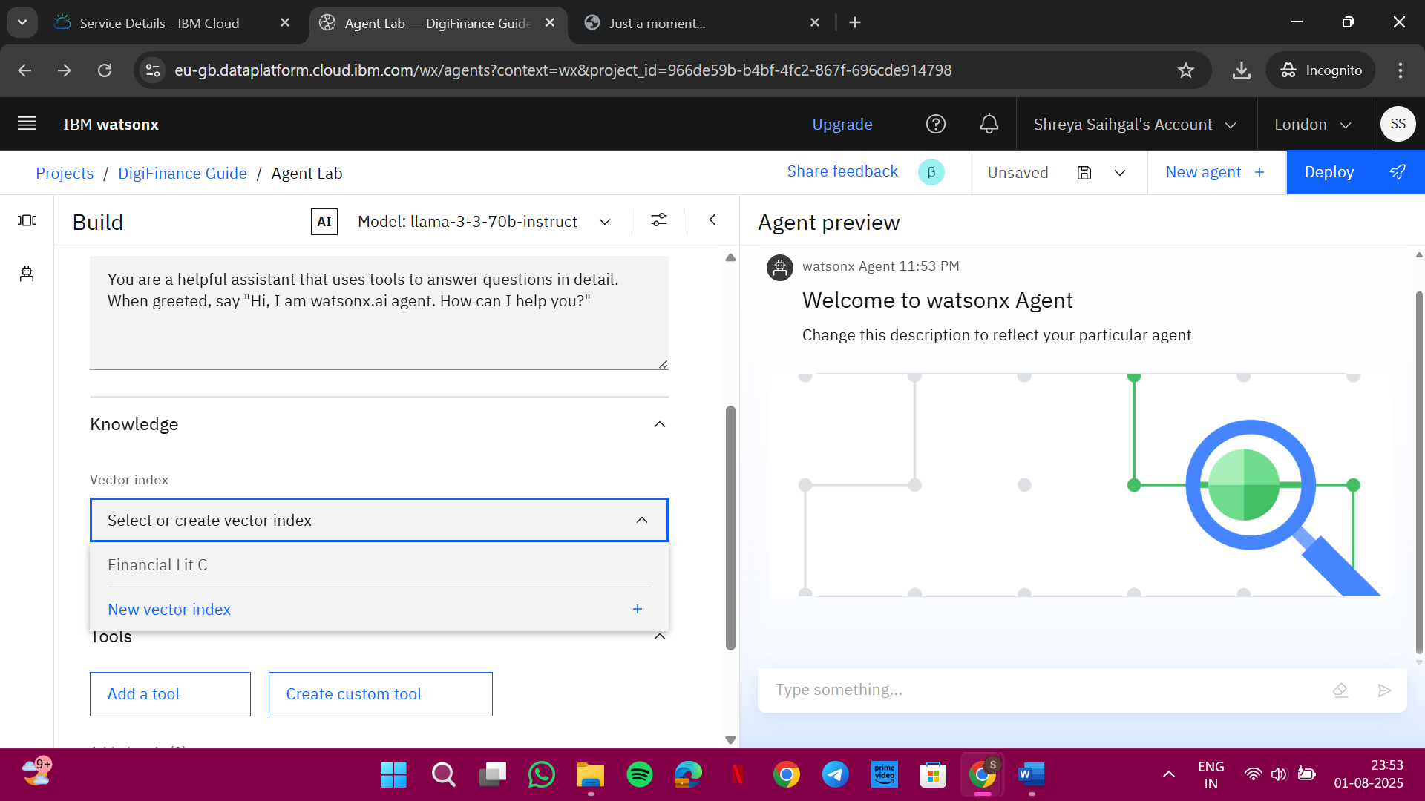
Result
Agent Preview

Slide 10
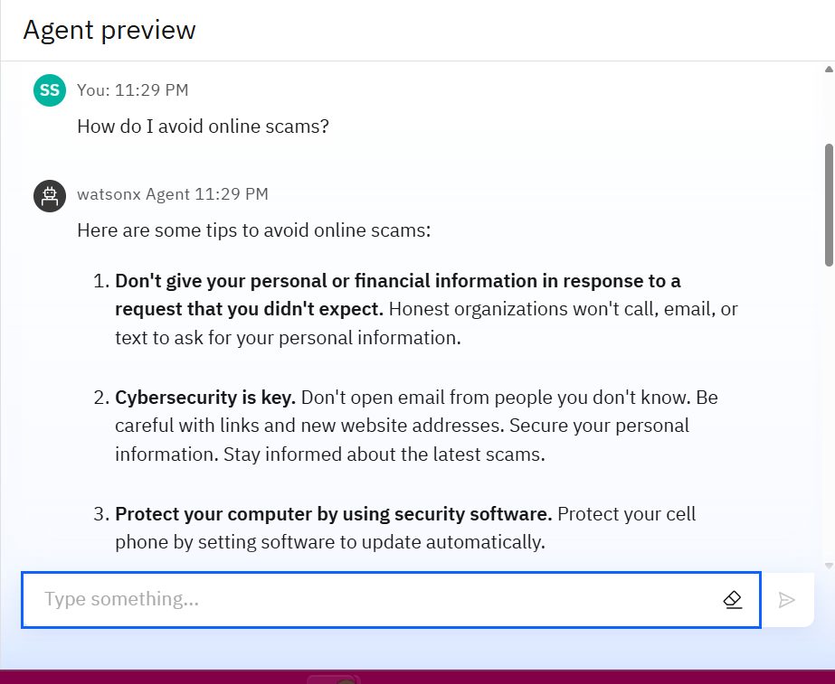
Result
Initial Testing

Slide 11
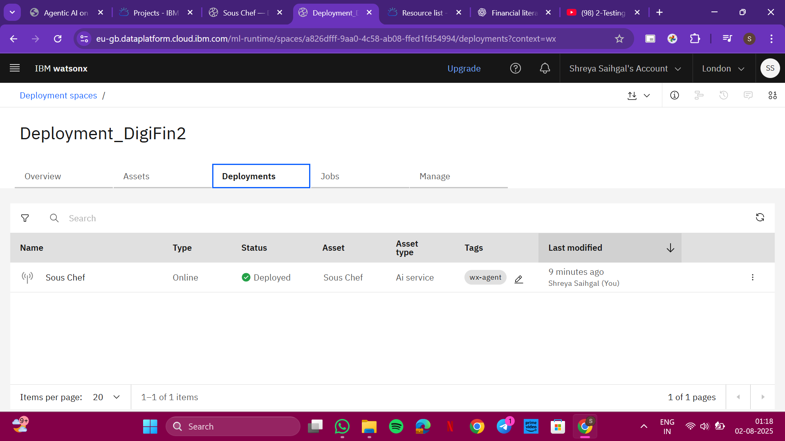
Result
Deployment Status

Slide 12
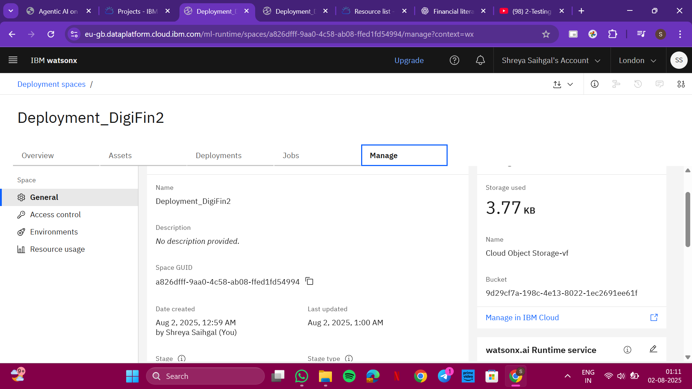
Result
Deployment Status

Slide 13
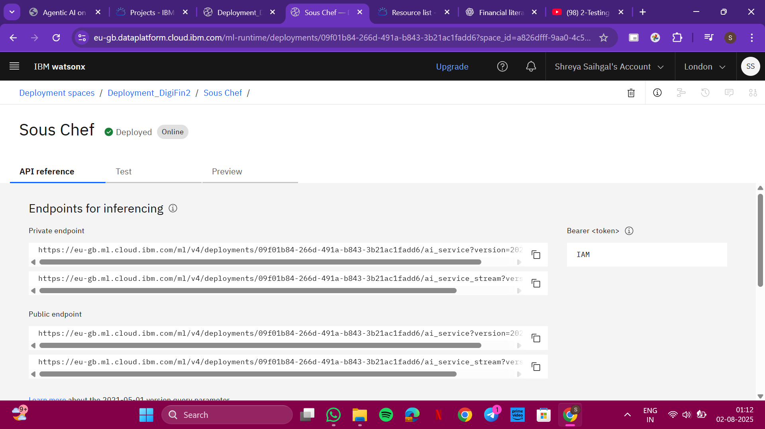
Result
API Reference

Slide 14
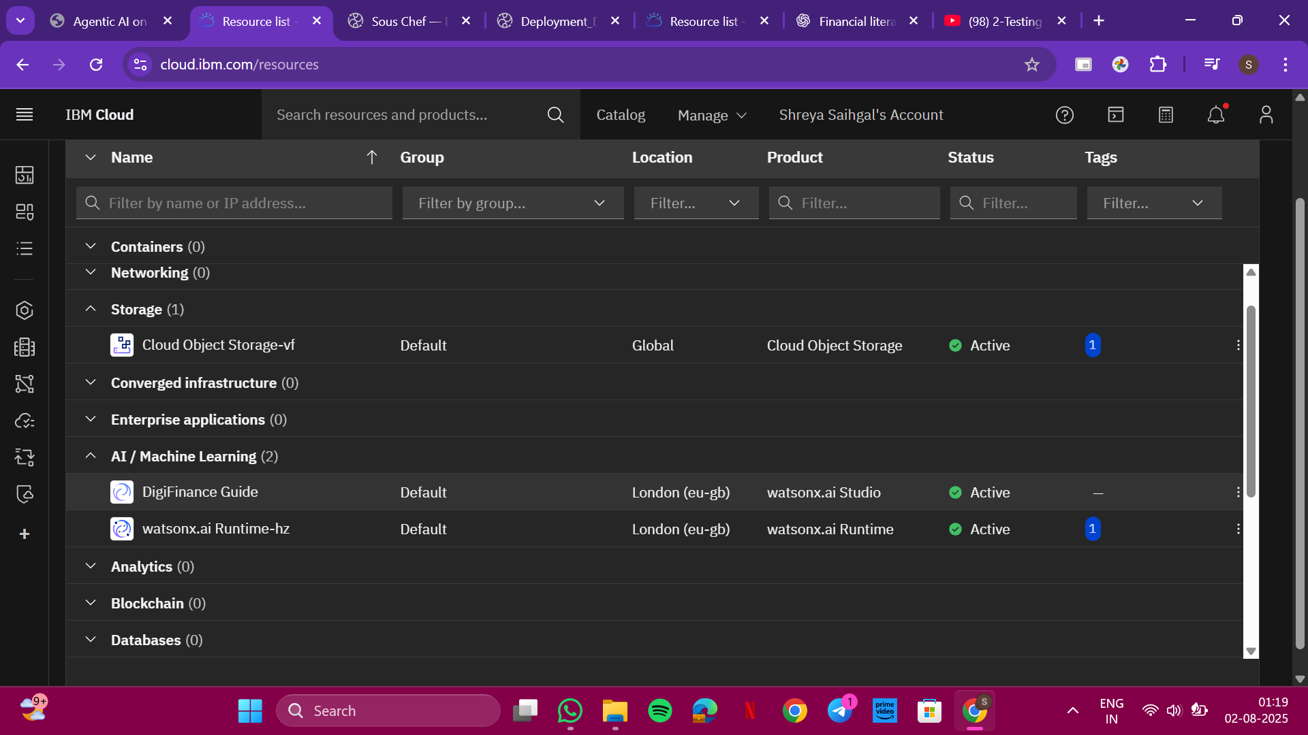
Result
Resource List

Slide 15
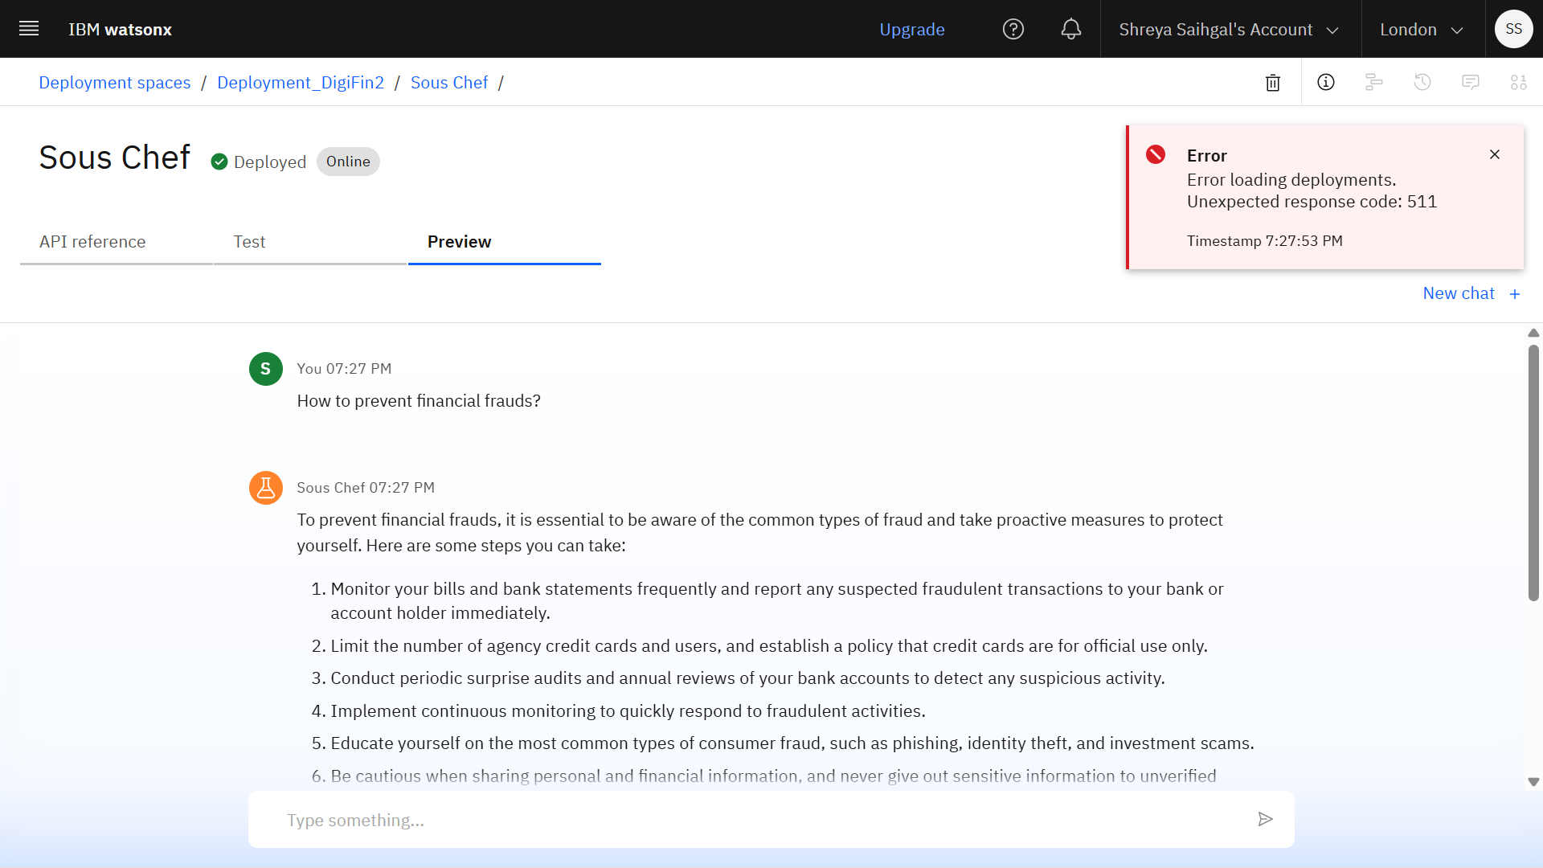
Result
Deployed AI Agent (English Conversation)

Slide 16
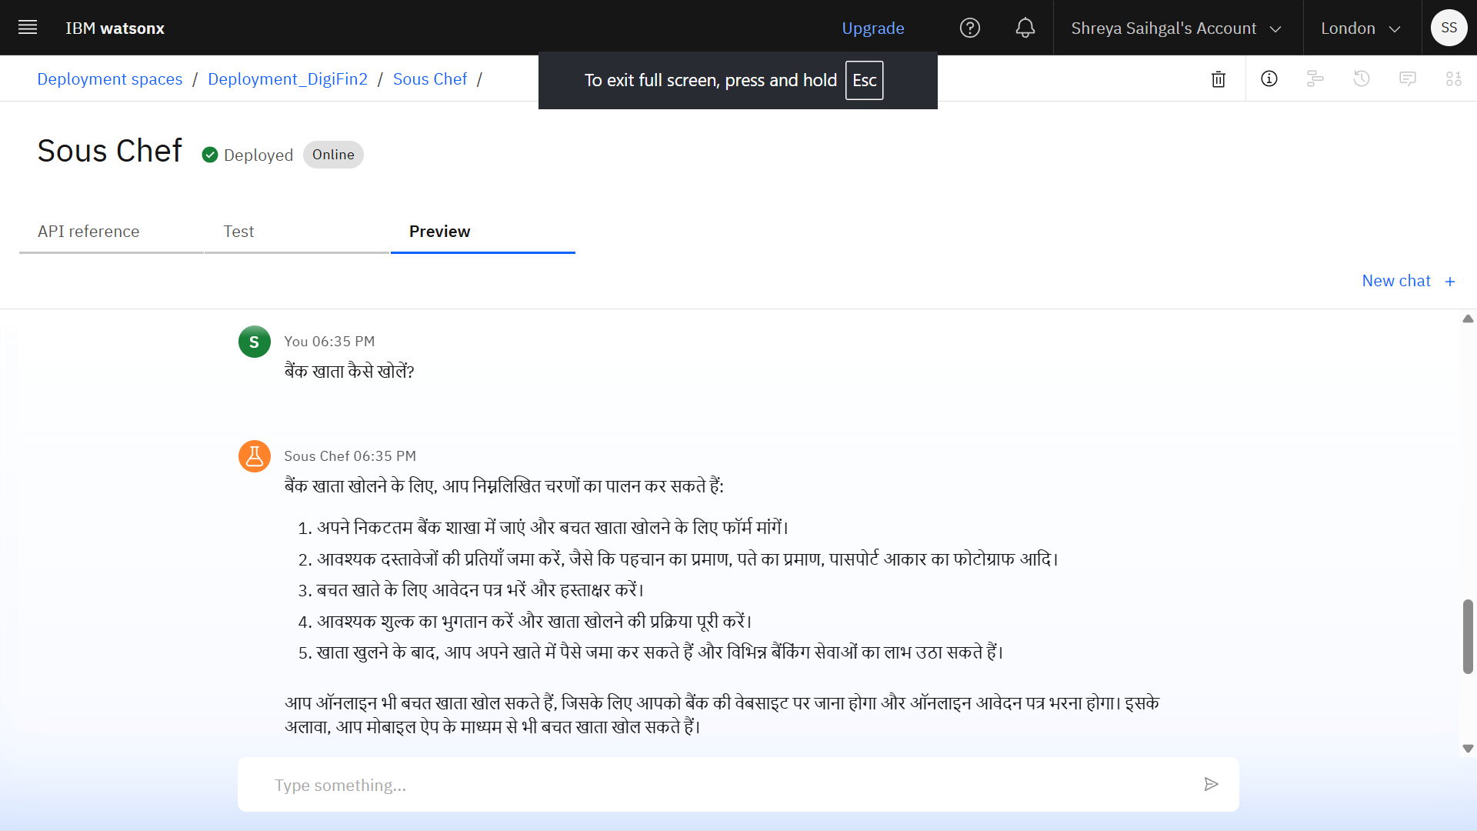
Result
Deployed AI Agent (Hindi Conversation)

Slide 17
Conclusion
The AI agent effectively bridges the gap between technology and financial literacy by making complex financial concepts easy to understand for all users, regardless of language or background.
It promotes accessibility by offering multilingual support, builds trust by retrieving data from verified sources and fosters inclusivity by catering to underserved and non-tech-savvy populations.
By equipping users with reliable knowledge and scam awareness, the project aligns with and supports India’s national mission of financial empowerment, aiming to reduce digital fraud, increase digital adoption and strengthen economic inclusion across communities.

Slide 18
GitHub Link
https://github.com/devsignedbyshreya/AI-Agent-for-Digital-Financial-Literacy

Slide 19
Future Scope
Add voice interaction for accessibility.
Expand to other sectors: healthcare, government schemes, insurance.
Train on regional-specific financial data and dialects.
Integrate with WhatsApp Business API for real-world deployment.
Collaborate with NGOs and financial institutions for outreach.

Slide 20
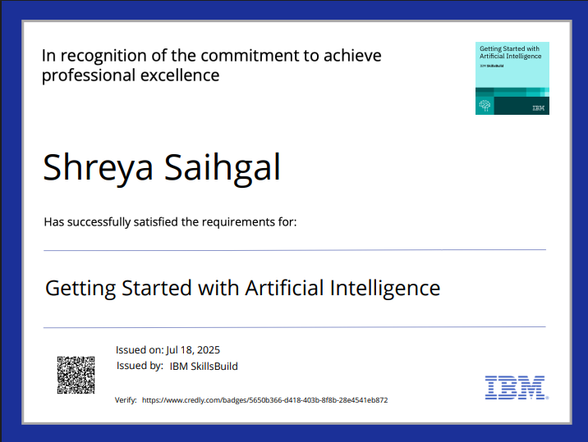
IBM Certification

Slide 21
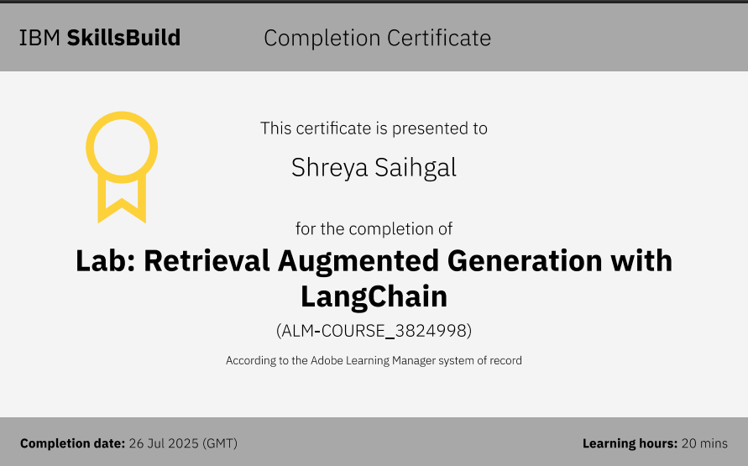
IBM Certification

Slide 22
THANK YOU

